Slide 1
Digital Transformation: Equipping Advisors for the Journey and Students for Success
FLORIDA PATHWAYS INSTITUTE 2021
Dr. Chris Hutt, NACADA
Dr. Kathe Pelletier, EDUCAUSE
Notes:
Abstract:
Digital transformation (Dx) is a term that appears everywhere these days, especially as changes to the social, economic, technological, and demographic landscapes are accelerating. responses show that Dx really is a student-centered endeavor; many key benefits of Dx are directly focused on student success. When seeking to improve student outcomes, Institutions are increasingly turning to academic advising as both a data source and a solution. Academic advising is increasingly data-informed and data-driven. This session will explore the intersections of Dx and academic advising, the current state of technology-enabled advising, and the potential benefits and risks to students and institutions.

Slide 2
Advising Success Network
Our vision is a higher education landscape that has eliminated race and income as predictors of student success through a reformed approach to advising, in which all students are supported through a seamless, personalized post secondary experience that creates better personal, academic, and professional outcomes.

Slide 3
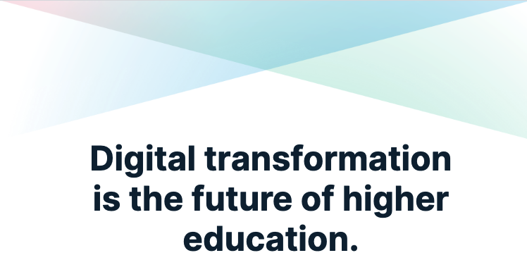

Slide 4
Digital Transformation in Higher Education
Digital transformation (Dx) is the process of optimizing and transforming the institution’s operations, strategic directions, and value proposition through deep and coordinated shifts in culture, workforce, and technology.*
*EDUCAUSE definition, adapted from Getting Ready for Digital Transformation: Change Your Culture, Workforce, and Technology

Slide 5
Understanding Dx – the 3 Ds
Transform the
institution
Streamline
processes
Automate
processes
5
Organize
information
Digitize
information
4
3
2
1
DIGITAL TRANSFORMATION
A series of deep and coordinated culture, workforce, and technology shifts that enable new educational and operating models and transform an institution’s operations, strategic directions, and value proposition.
DIGITALIZATION
Using digital technologies and information to transform individual institutional operations.
DIGITIZATION
Changing from analog or physical to digital form.
SOURCE: Consider the 3 Ds When Talking About Digital Transformation

Slide 6
It’s More Than an “IT Thing”
Digital transformation...
Relies on institutional leadership to understand and champion the changes
Builds on the core values of higher education and of the institution
Involves a foundational shift such as changes to the underlying business model and approach
Requires changes that are holistic in nature
Enables an institution to differentiate itself
Involves continuing effort–it’s not a “once and done” solution

Slide 7
The Dx Equation
Intentional change in institutional value proposition or direction
Shifts in culture, workforce, and technology
+
=
Digital Transformation

Slide 8
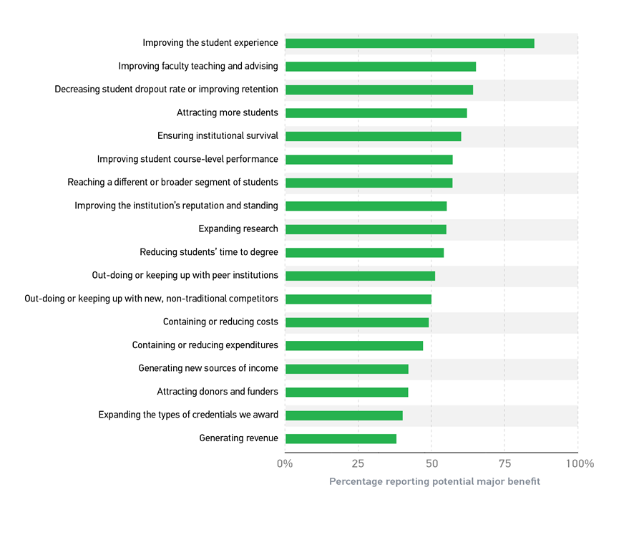
Dx is student-centered
SOURCE: Dx and Students

Slide 9
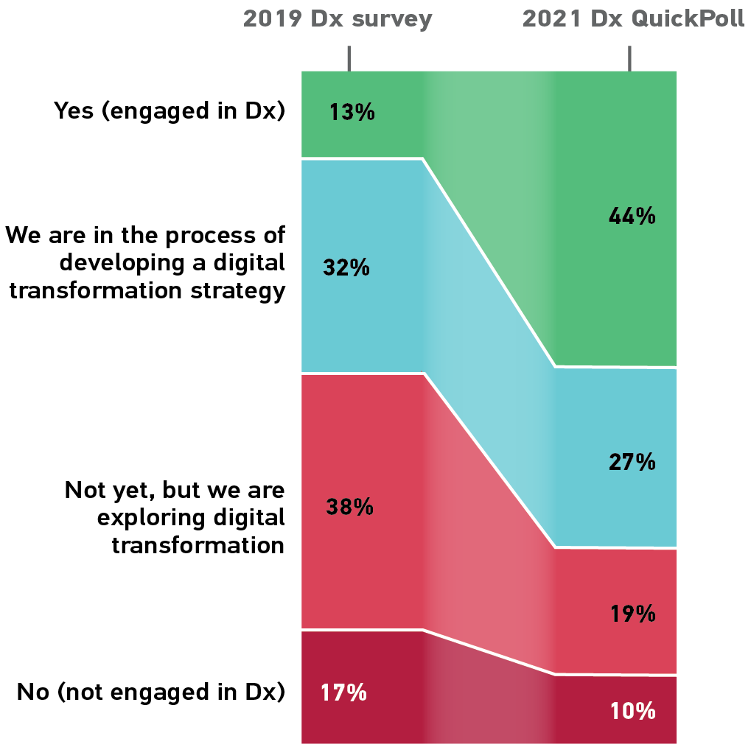
Dx is accelerating
SOURCE: EDUCAUSE QuickPoll Results: Institutional Engagement in Digital Transformation

Slide 10
How Does This Apply in Advising?
What were your experiences as a student?
What do we mean by ‘advising’?

Slide 11
What Does Good Advising Look Like?
S
Sustained
Support is ongoing, rather than using an “inoculation” approach.
S
Systematic
Services are differentiated to maximize capacity
I
Integrated
Services are not viewed as stand-alone interventions.
P
Proactive
Services are an integral part of all students’ experiences
P
Personalized
Students receive the support they need when they need it, from an individual who knows them well

Slide 12
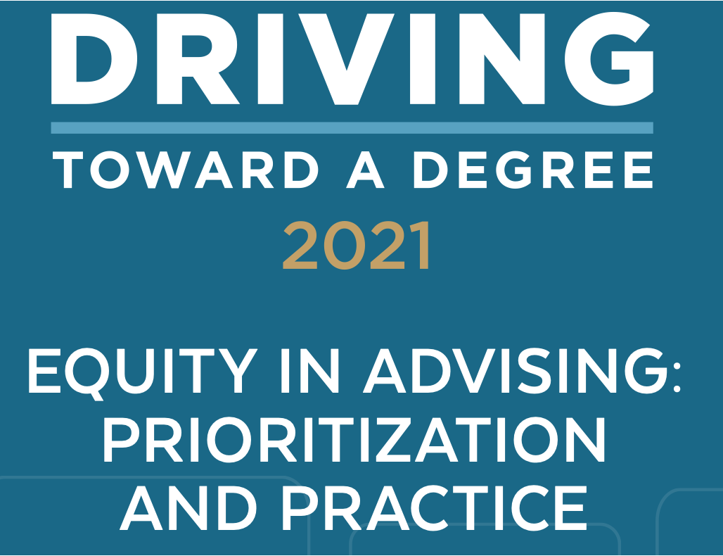
How Does This Apply in Advising?

Slide 13
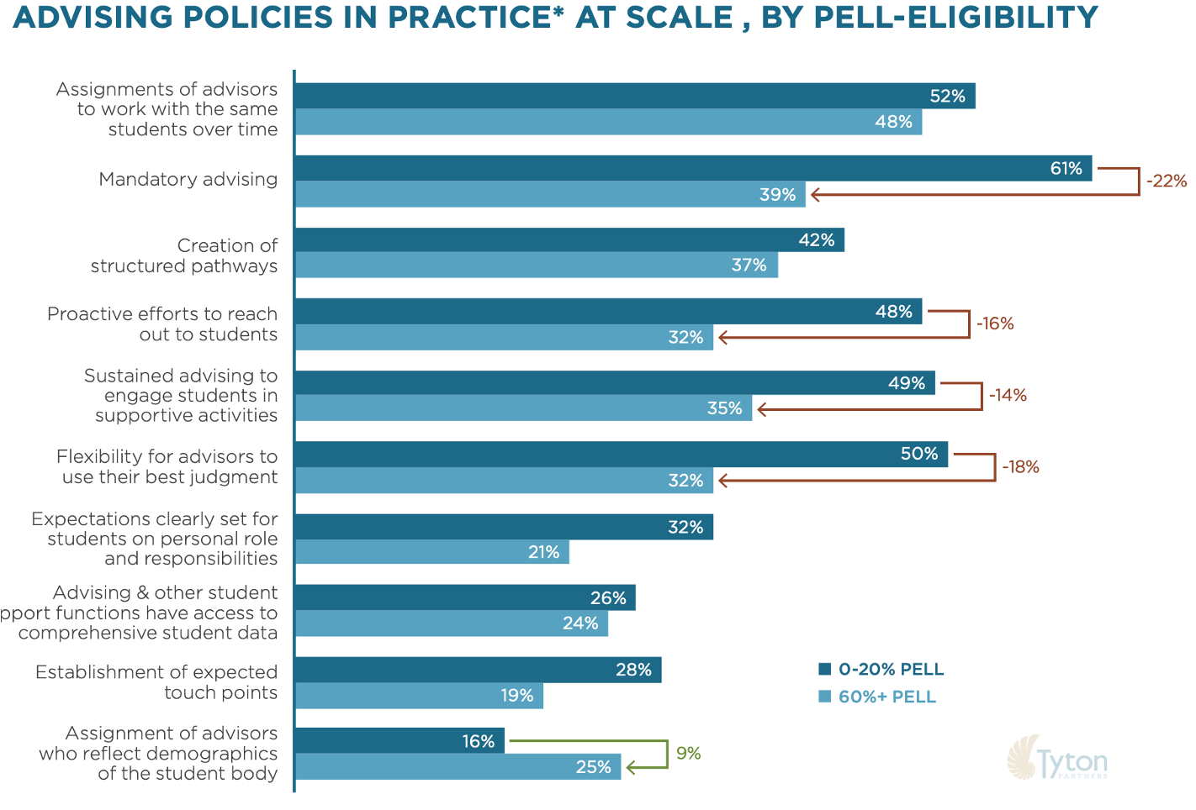
What Initiatives Have the Greatest Impact?

Slide 14
How Can You Advocate for Dx?

Slide 15
Signals: Are You on the Journey?
Culture
Workforce
Technology
The EDUCAUSE Dx checklist is a tool to help you to get a sense of your institution’s progress on the Dx journey and to learn about how you can move forward
Notes:
This would be a great place to engage audience -
Are these things happening on your campus, and if so, why not? Even if resource constraints, how can you leverage technology to enable SSIPP
What are the indicators/signals that you are on the right path? (See EDUCAUSE Dx checklist (general to HE) or advising detail/example signals from the Best Practices logic model and survey instrument)
Pathways work sets them up - cross-functional, student-centered, curriculum updates, etc
https://er.educause.edu/blogs/2019/10/digital-transformation-signals-is-your-institution-on-the-journey

Slide 16
Missteps, And How to Avoid Them

Slide 17
Apply: How Can Technology Enable SSIPP?
S
Sustained
Support is ongoing, rather than using an “inoculation” approach.
S
Systematic
Services are differentiated to maximize capacity
I
Integrated
Services are not viewed as stand-alone interventions.
P
Proactive
Services are an integral part of all students’ experiences
P
Personalized
Students receive the support they need when they need it, from an individual who knows them well
Notes:
Engage audience -
S: how can we use technology and data to ensure support is ongoing - e.g. Pathways students are even going from one institution to another.
Capture advising history and byproducts of relationships established are persisting, beyond a transcript

Slide 18
Questions?

Slide 19
Resources
The following resources are available for institutions seeking to develop capacity in Dx

Slide 20
An Introduction to Digital Transformation
Download these slides for use in your own institutional presentations to advance Dx
Available at:
dx.educause.edu
Notes:
A slide deck you can download and use to introduce Dx with a group of people at your institution

Slide 21
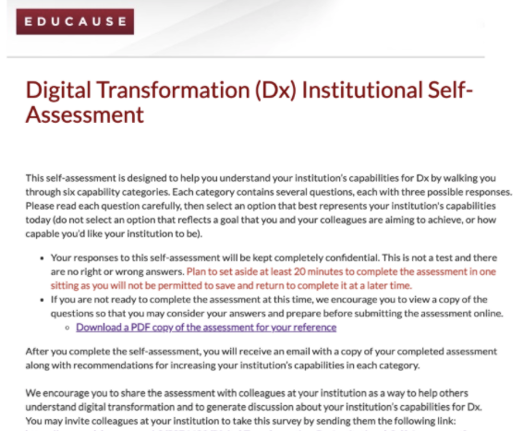
Dx Institutional Capabilities Self-Assessment
Available at:
dx.educause.edu
Notes:
It helps to understand more about your institution’s readiness for digital transformation. EDUCAUSE has a Dx self-assessment you can take to identify areas to focus on.

Slide 22
Develop an Institutional Digital Transformation Strategy
Available at:
dx.educause.edu
Notes:
EDUCAUSE has a tool you can use to start drafting your next Dx journey. Our Dx strategy-on-a-page helps you work with a group at your institution to clarify the impact you hope to have and then the work you’ll need to do to get there.

