Slide 1
USING COLLEGEWIDE
CASELOAD MANAGEMENT
WITH FTIC PRE-REGISTRATION
TO ONBOARD NEW APPLICANTS
Florida Pathway Institutes III
PRESENTERS
Bryan Anderson, District Director, Enrollment Management
Kimberly Adams Goulbourne, Associate Dean, Student Services

Slide 2
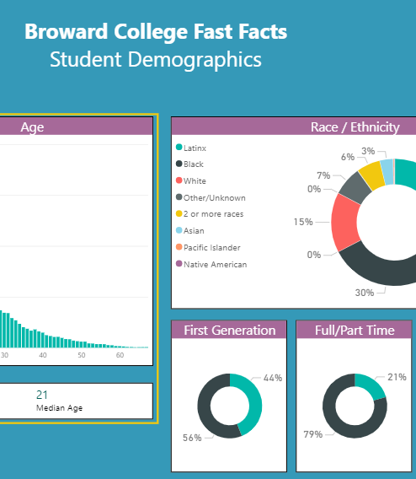
Overview of Broward College
We are a minority serving institution focused on underserved areas in Broward County
55,000 students enroll annually
8 campuses throughout Broward County
150 plus programs including Bachelors, Associates, and Certificates
Receive 30,000 applications on average per year - FTIC, Re-admit, Transfer
Notes:
Population of Broward is 84% other than white. We are 69% Black or Latinx.

Slide 3
Challenges
The application/onboarding process is confusing, especially for first generation students
Applicants need personal attention
Large caseloads – not enough personal attention
A Lack of technology to efficiently engage with students e.g., CRM
Coaches using multiple systems to work caseloads
Inability to track coach conversion rate, performance, and overall effectiveness
Processing is too slow

Slide 4
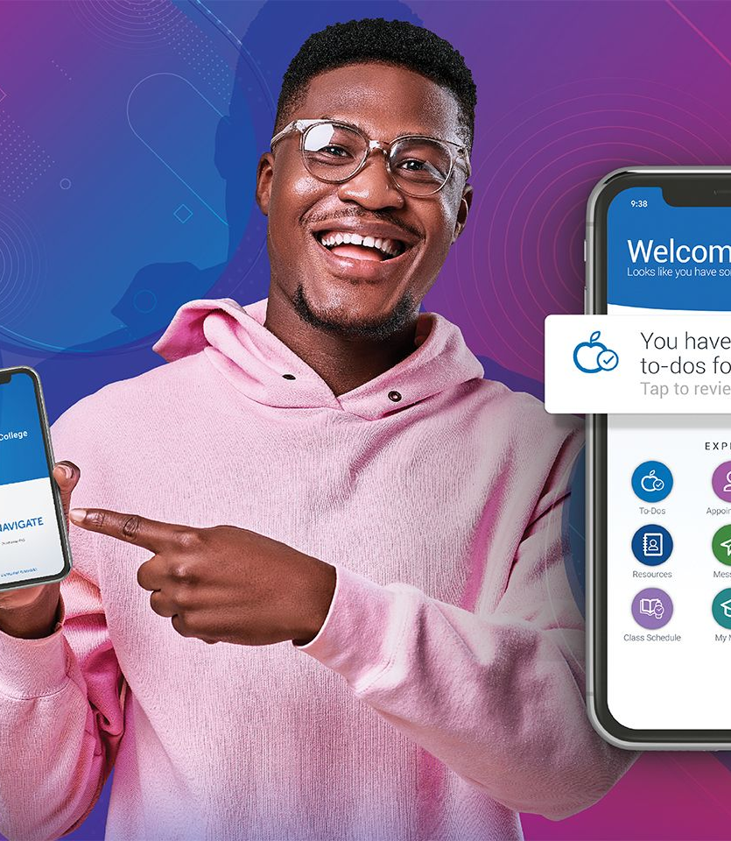
Solutions
Analyze and Document all stages of the Onboarding Process
Hired a Work Study "Army"
Implemented Different Layers of Onboarding e.g. Jumpstart, FAU Link
Launched impactful enrollment campaigns
Introduced a new welcome letter
Designed a new onboarding website
Create a Seahawk Intake Form
Utilized Navigate more robustly
Notes:
A&R's
Warm hand off

Slide 5
Process Improvement: Coaches
Hired dedicated student onboarding coaches: 8 FTIC, 6 transfer, 3 career and technical education
Onboarding Coaches:
Are assigned a caseload of students that they onboard from applicant to paid first term enrollment
Create rapport with student starting with the career conversation
Assist with immigration, residency, transcript process and financial aid application
Create the student academic plan in Navigate which details the courses required to complete their chosen degree
Utilize Navigate to create campaigns to engage students during each step of the process

Slide 6
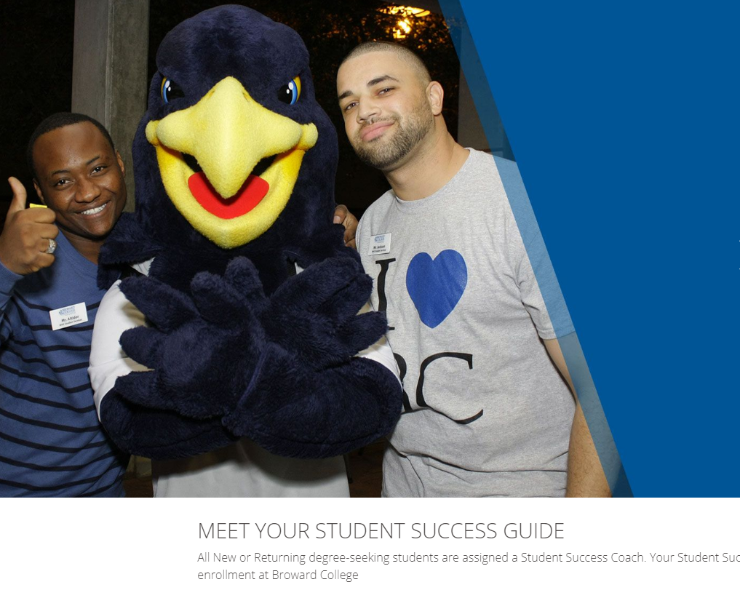
Process Improvement: Welcome Letter
Revamped the New Student Welcome Letter
Created a new Student Onboarding-Next Steps website

Slide 7
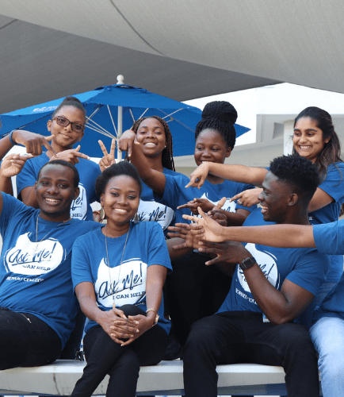
Process Improvement:
Intake Form
During the pandemic, we experienced a decline in FTIC enrollment
Low student engagement
Met with local institutions ( Miami Dade and Palm Beach) to share best practices
Highlights of Pre-registration Form:
Pathway
Preferred date and time of class meetings
Preferred modalities
How the student plans to pay for classes
Financial aid application assistance
Notes:
We adopted Miami Intake Form.
We named our form “The Seahawk intake Form”
One of the coaches out campaigns includes the intake form.
The coach uses this form to register the student for their first term classes
Student receives an invite to attend an Advising and Registration session to review the classes added to their schedule and register for their first advising appointment
The student remains in the coaches' case load until they registered and paid

Slide 8
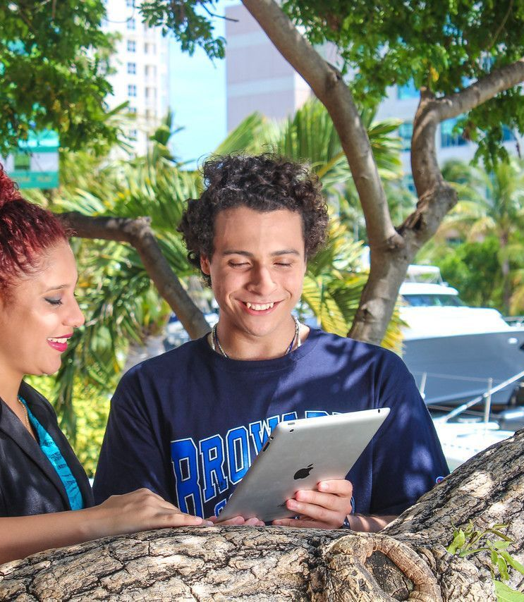
Process Improvement:
Transfer Articulation
Speed up the transcript evaluation process to 1-2 days from date of receipt.
Notes:
To support this goal:
Automate the conversion of print and PDF post-secondary transcripts into electronic format using OCR technology Automate articulation of consumed electronic transfer credit format using established course equivalency rules.
Develop OCR solution that will enable higher volume processing without requiring additional staff by systematically initiating course equivalency articulation rules.
Create an opportunity to process at a fraction of current processing times and eliminate high risk manual keying errors during transfer student’s external academic history data.
Confirm baseline data on transfer applicants who provide post secondary transcripts and do not enroll to create a baseline percentage to measure improvement impact as a result of implementation.
Tactical Update:
Finalize vendor selection by October and pursue vendor contract with legal review. Following contract approval, create IT project to support solution implementation by the end of the Spring 2022 term. * Timeline is dependent on the level of effort and IT resources.
Lead Indicator Progress:
Complete vendor product demo reviews for delivering the best articulation automation solution to Broward College.
Identify the source vendor to provide OCR transcript conversion and auto evaluation solution.
Engage IT in determining the level of effort and scope of work to meet the anticipated implementation timeline.

Slide 9
Results:
> 2800 students completed and registered since implementing the intake form
FTIC enrollment is up for the Fall term
Goal to increase transfer student enrollment by 3-5%.
Freedom to be innovative and creative leading to improved Coach moral

Slide 10
Keys to Success
Extensive communication with students, including texting
Teamwork
Regularly scheduled best practices meetings
Strong partnerships with other departments (FA)
Fostering creativity among Coaches
Ability to track and report
Notes:
To provide additional support to coaches, included them in Admissions and Advising weekly meetings

