Slide 1
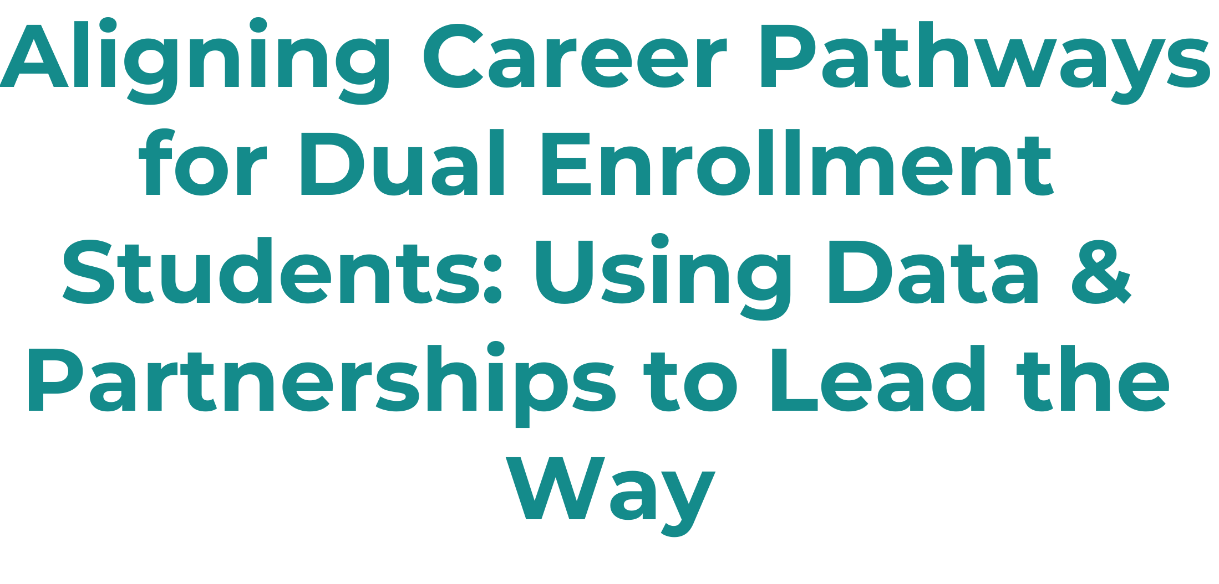
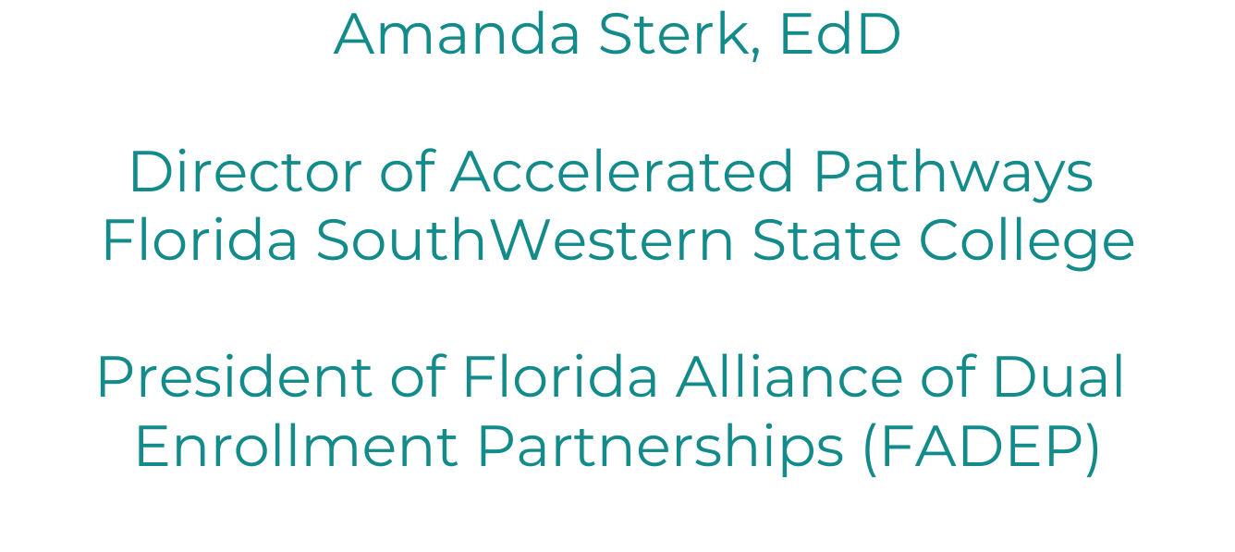
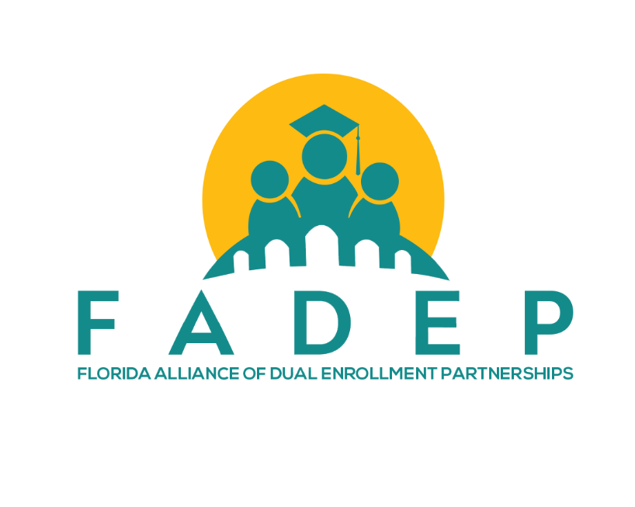

Slide 2
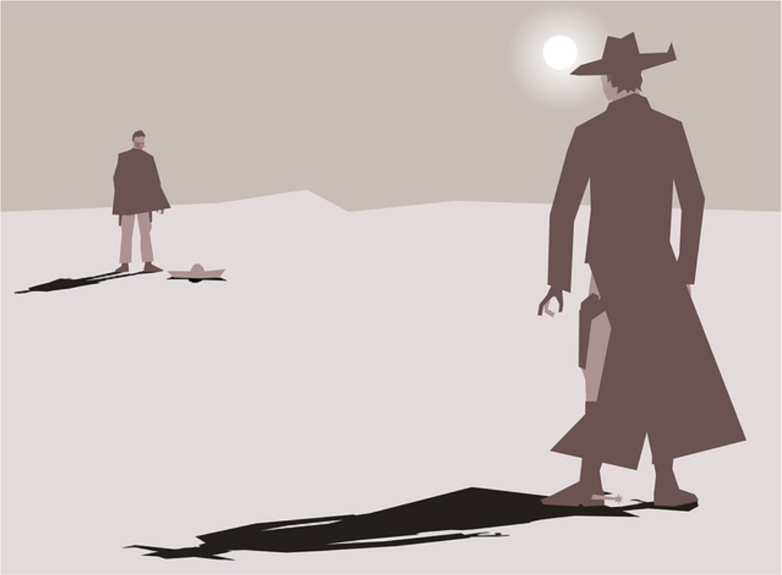

Slide 3
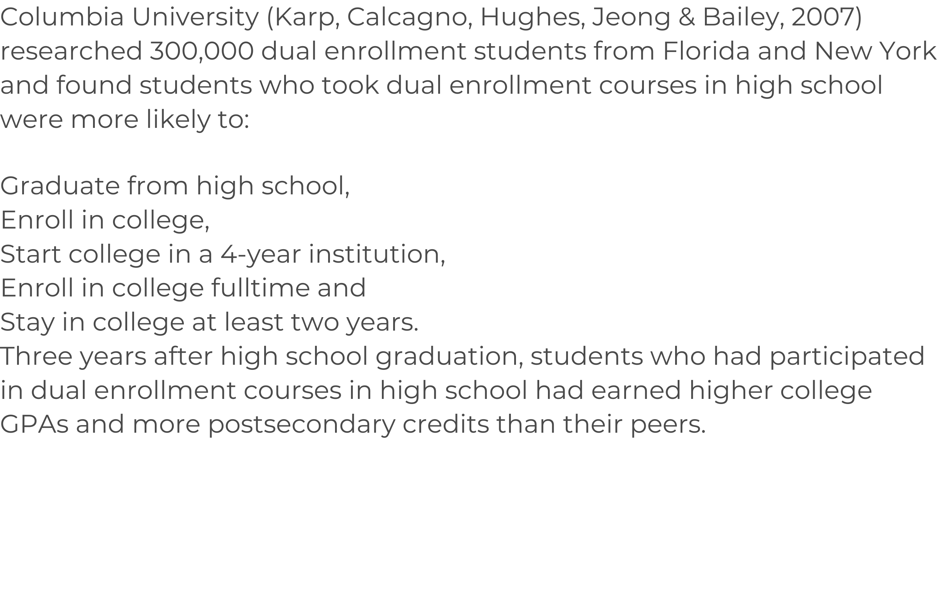

Slide 4
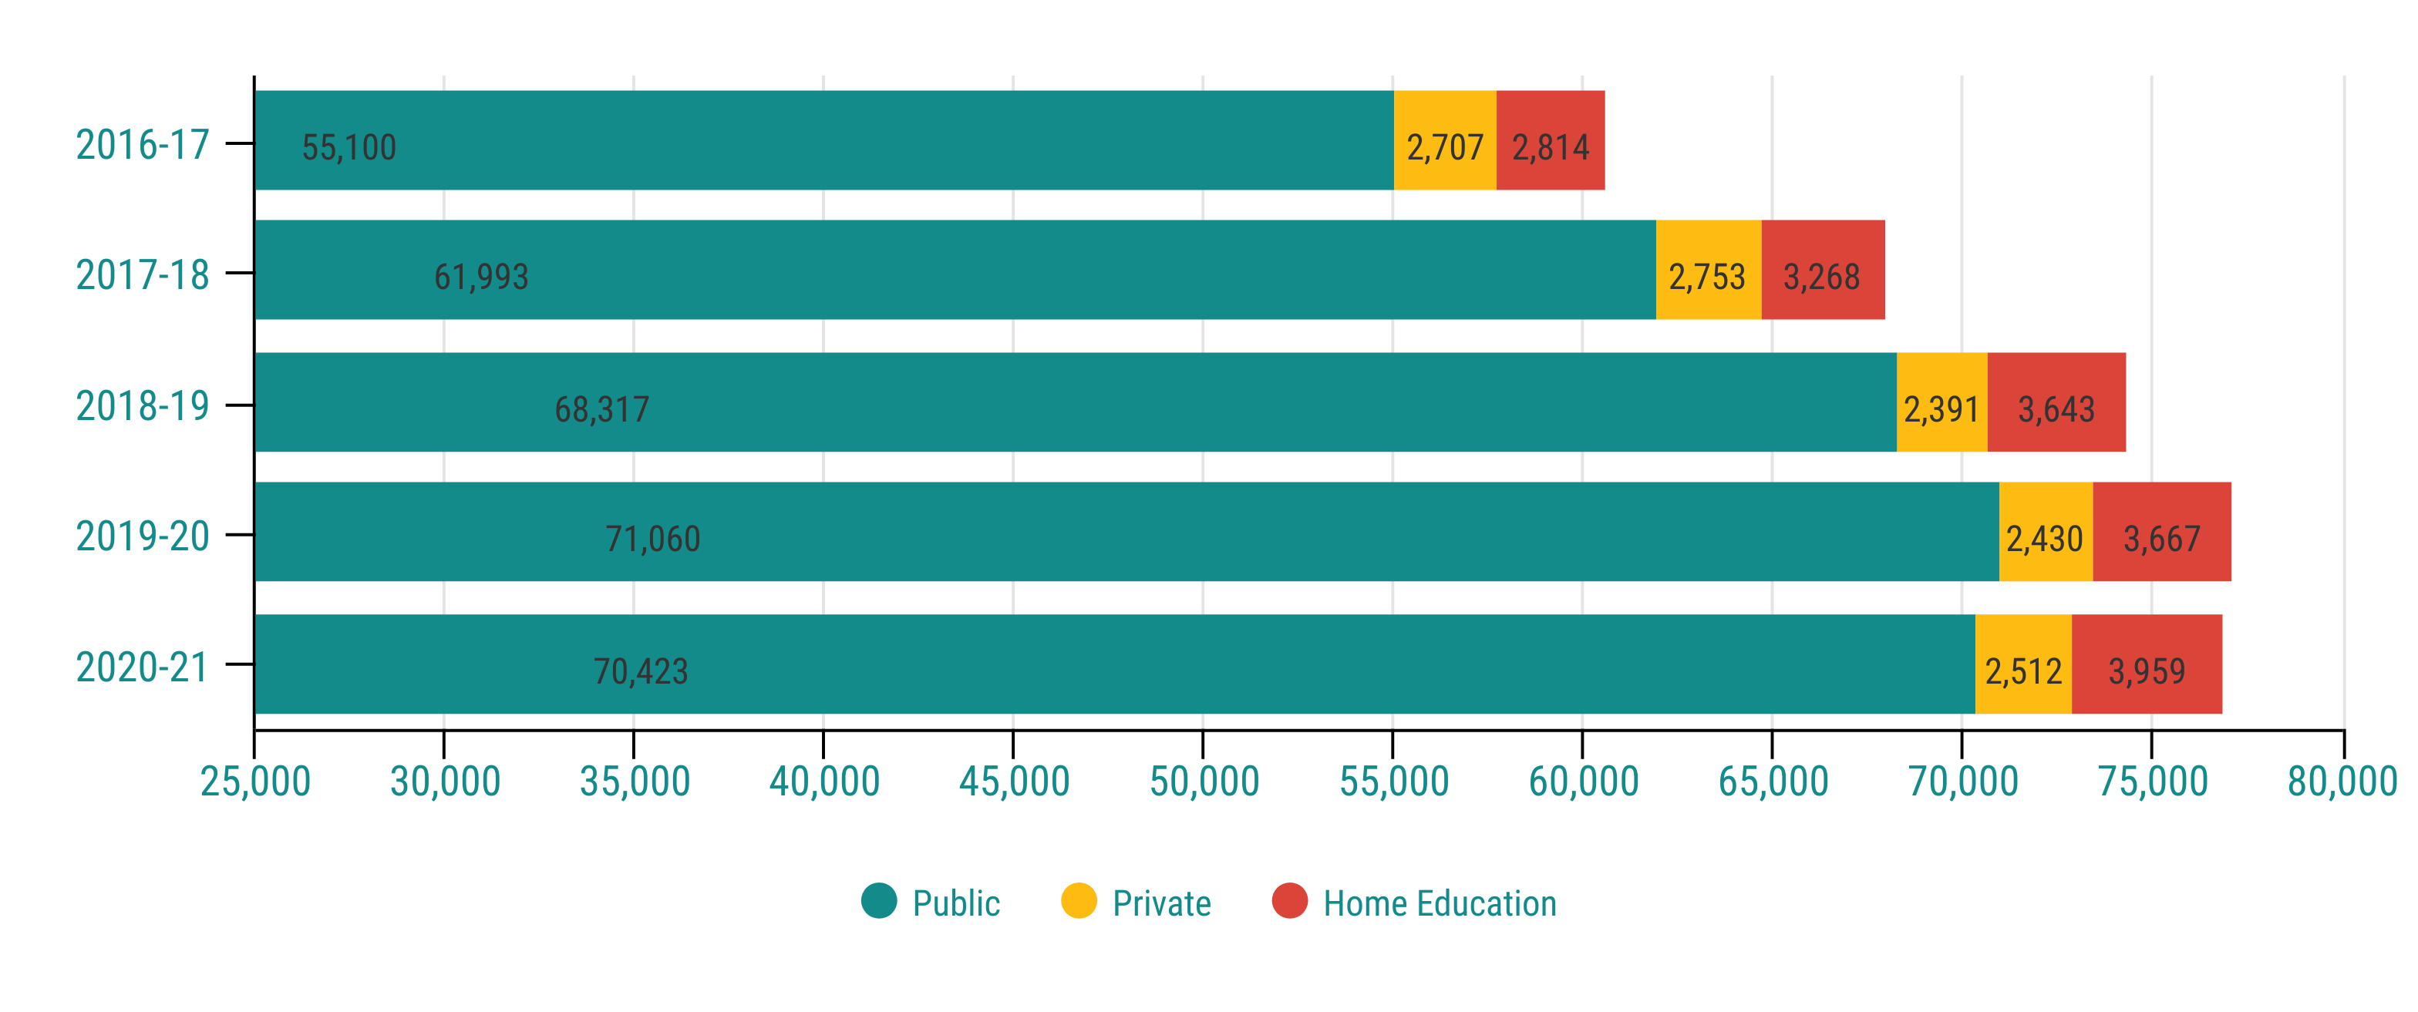

Slide 5
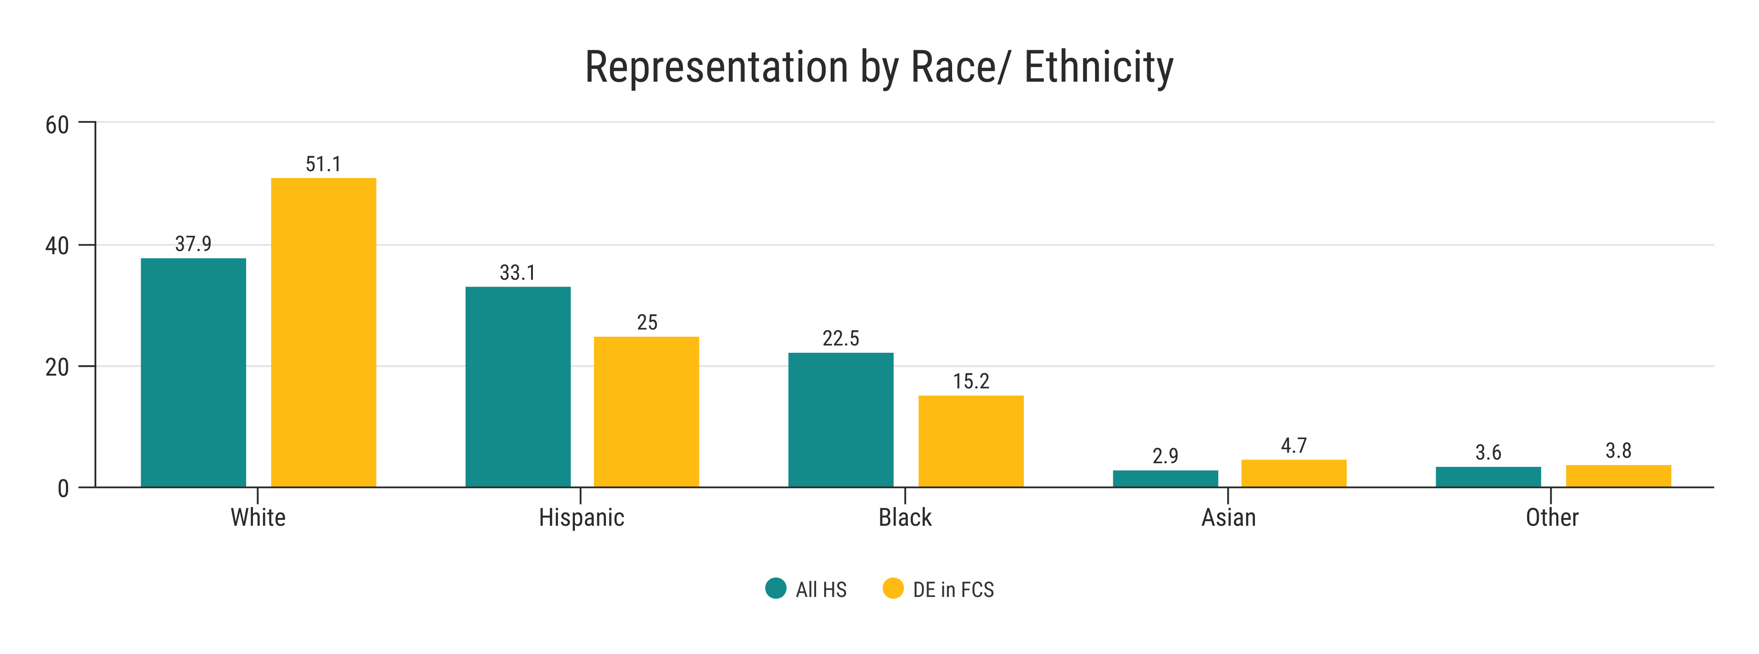

Slide 7
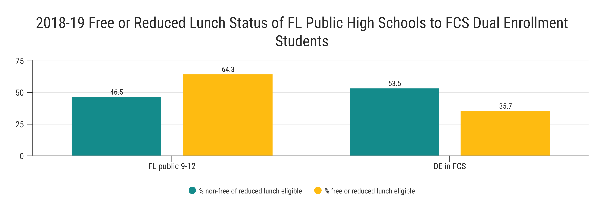
Florida DE students (2007-2012 data) were 18% less likely to receive FRPL than non-DE students (CCRC, 2020).

Slide 8
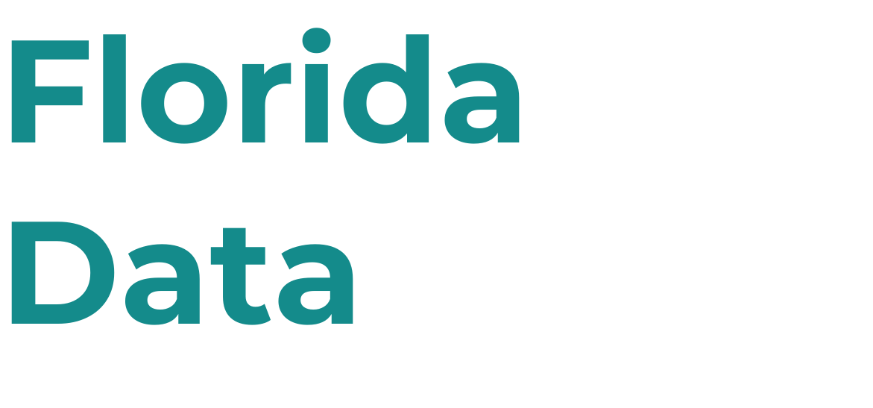
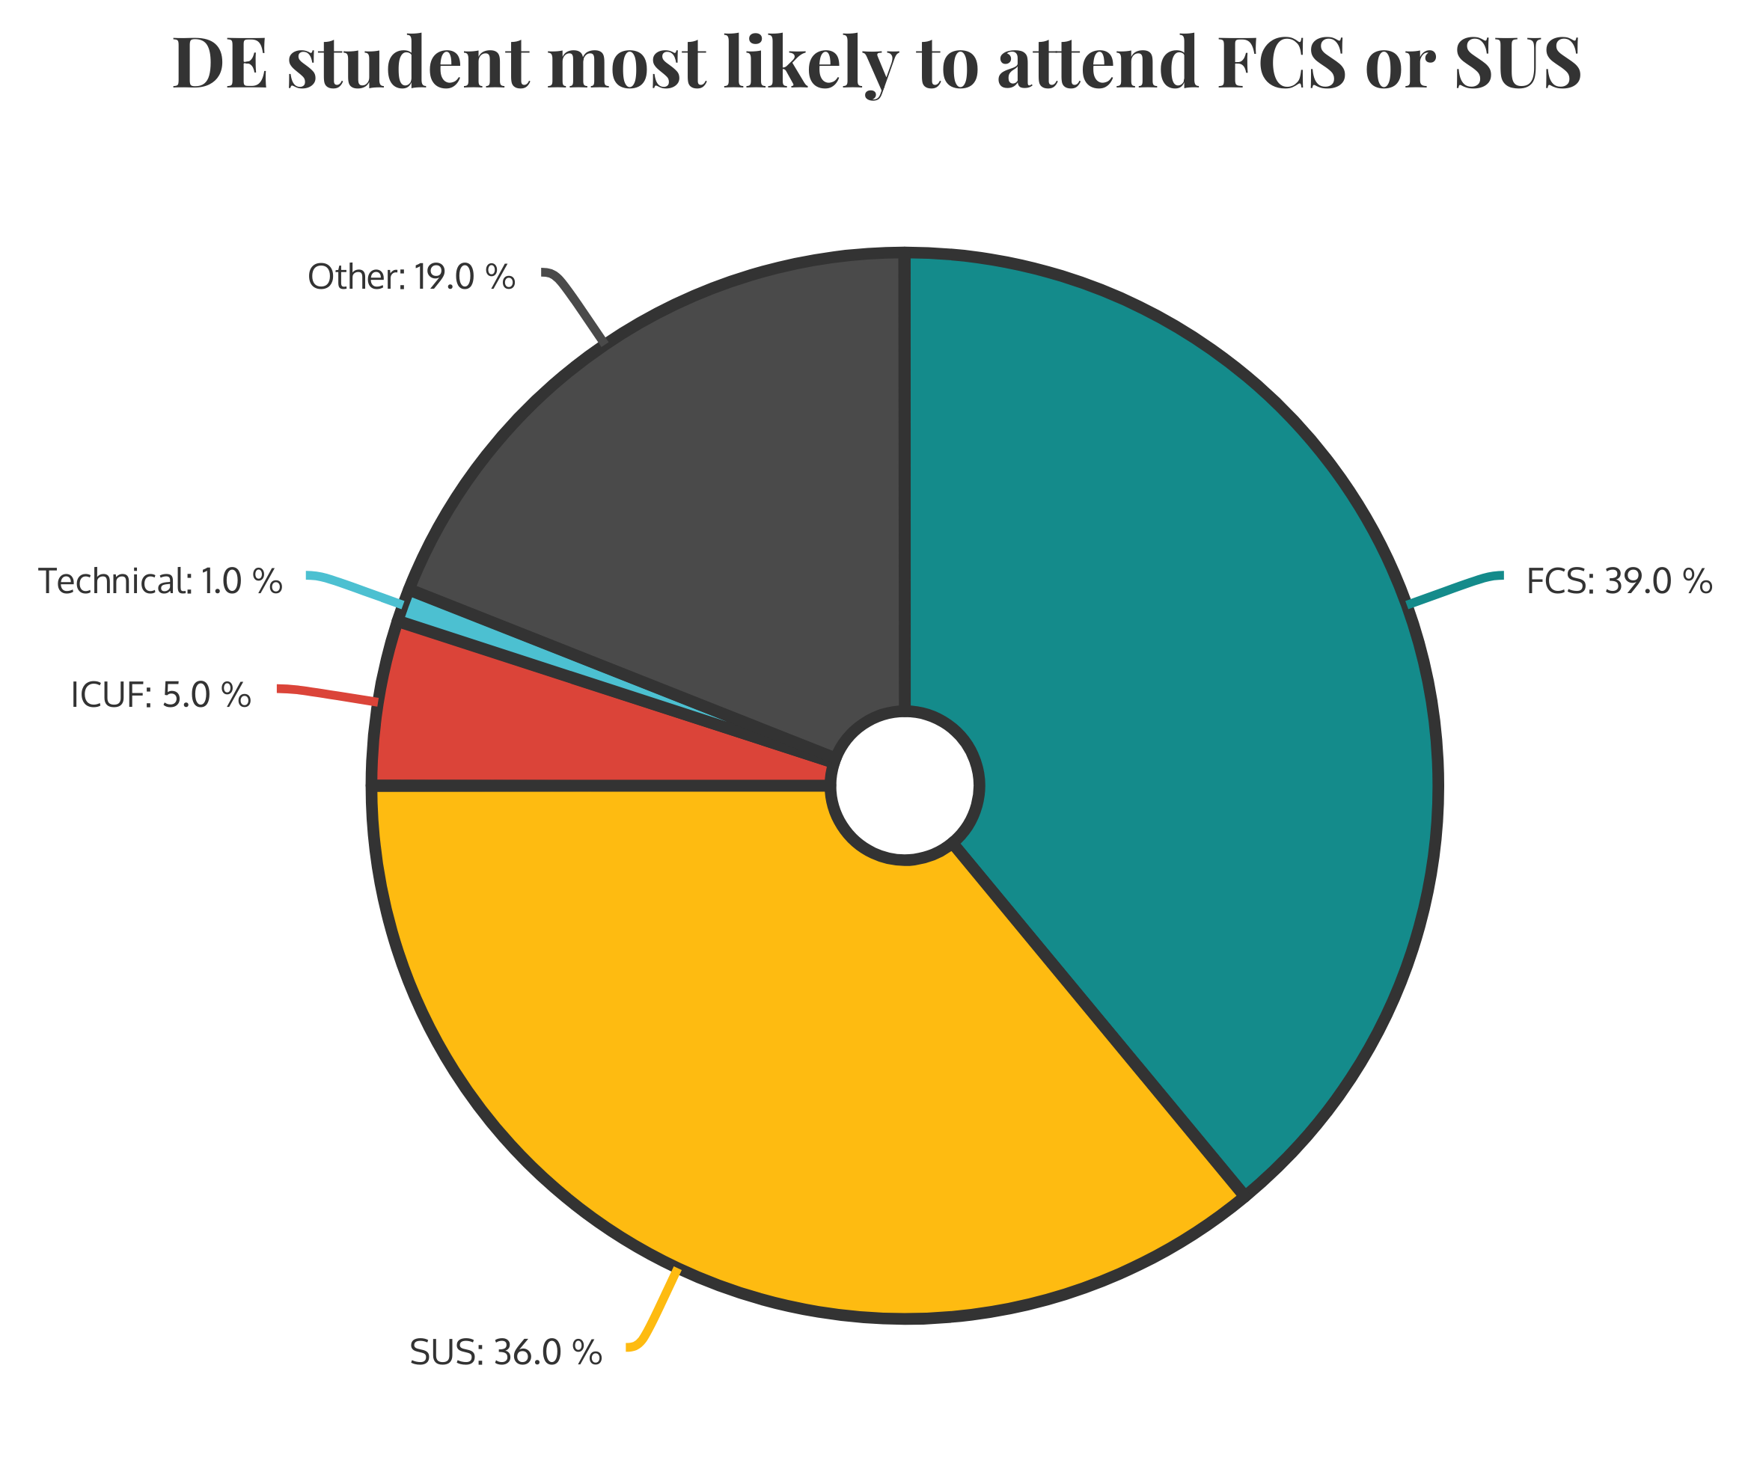

Slide 9
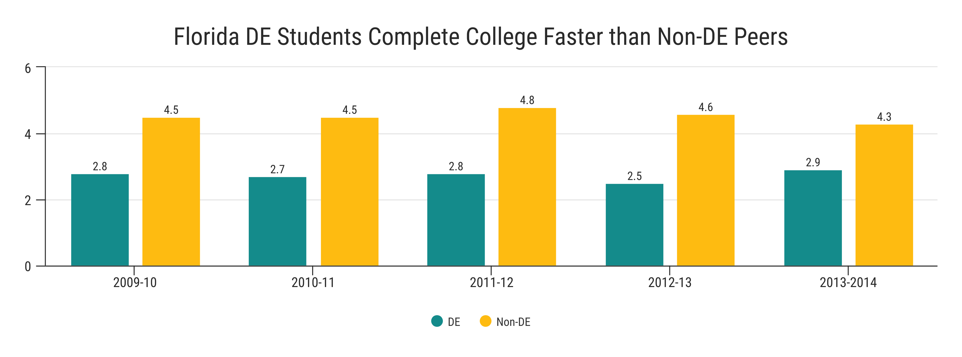

Slide 10
55,346
63,212
334,193
Fl. students received a 3,4,5 on AP
Fl. students participate in AICE courses
Fl. students participates in CTE
https://www.fldoe.org/newsroom/latest-news/florida-soars-on-advanced-placement-performance.stml
https://www.flsenate.gov/Session/Bill/2021/918/Analyses/2021s00918.aed.PDF
https://cte.ed.gov/profiles/florida

Slide 12
High Schools
Limited storage
Easy integration
Career Pathways
SUS
FCS

Slide 14
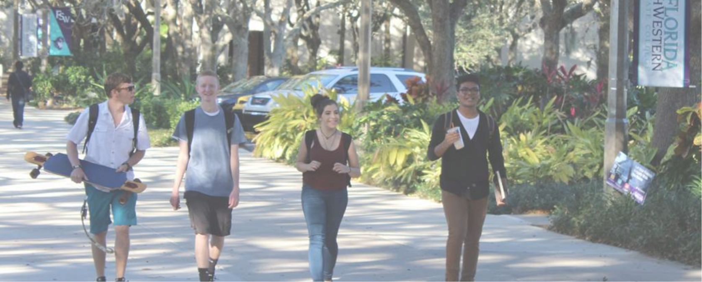
Collaboration
Who should be at the table? Develop team early Short term vs. long term Annual vs. bi-annual 1 Institutional Agreement
Small to medium businesses need a range of artists (graphic designers, video editors, musicians, writers) to create unique content.
Partnerships
How to support one another (K-12/ FCS) Other areas of growth Frequent review
Artists of any age and talent level can connect with employers who need their services.

